Slide 1
Classification Model Presentation
Methodology
and Results

Slide 2

Methodology
1
Data Cleaning
3
Prediction model selection
2
Describing difference between segments
4
Building a model

Slide 3
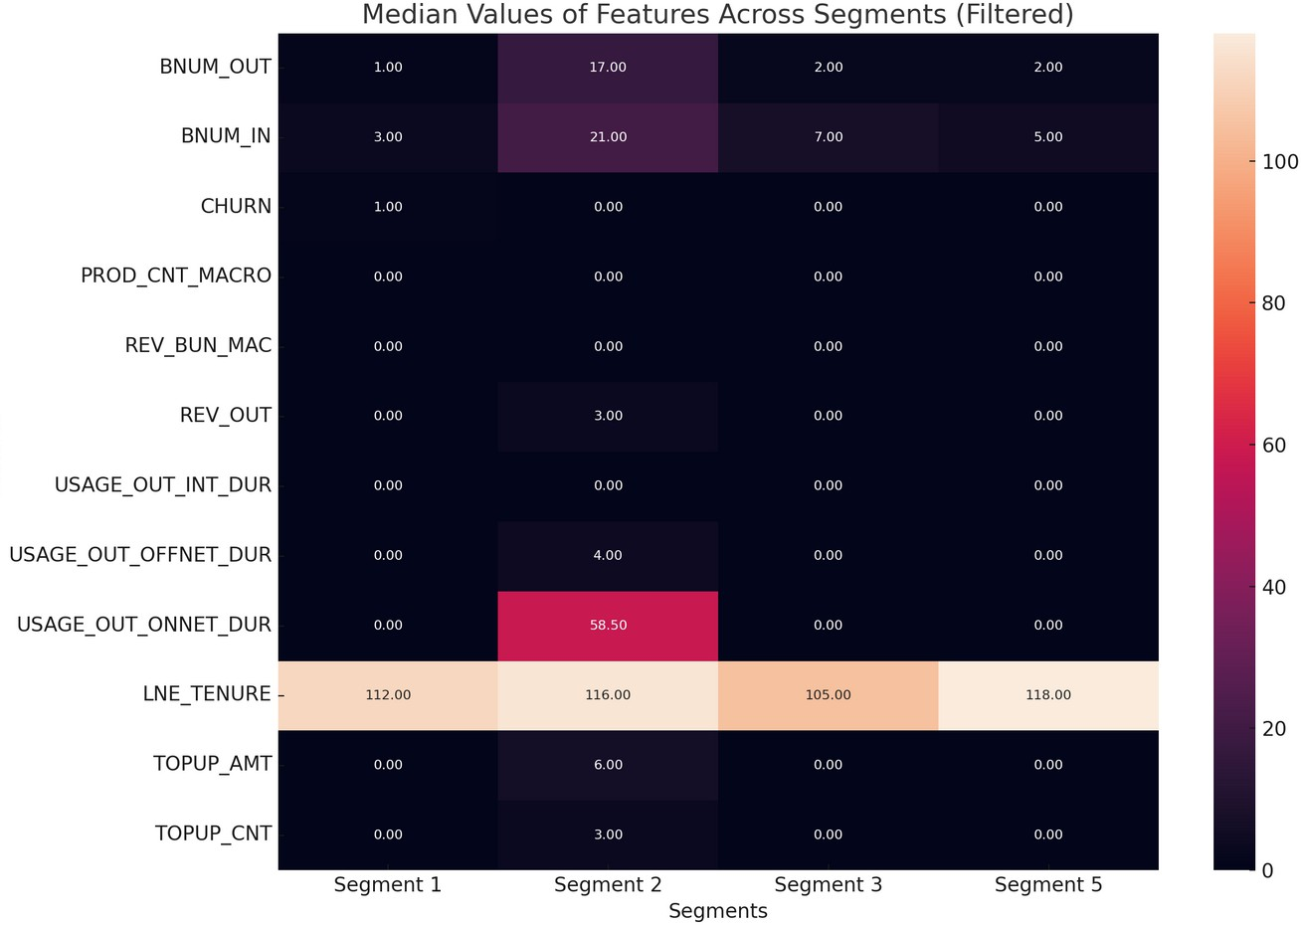

Difference between identified customer
segments
The first difference is that Segment 1, unlike the others, has a 100% churn rate, while the others
1
have a 100% retention rate. Additionally, the medians of the features in Segment 1 are lower than the others.
The t-test results showed we cannot reject the null hypothesis, meaning there is no reason to conclude that the averages differ.
2
This may indicate that the sample is biased compared to the general population.
Collaboration with Data Engineers has helped improve the data quality for further investigation of our target user groups.
3
The Segment feature proved highly significant for modeling, effectively differentiating clients by behavior and enhancing both model accuracy and interpretability
4

Slide 4
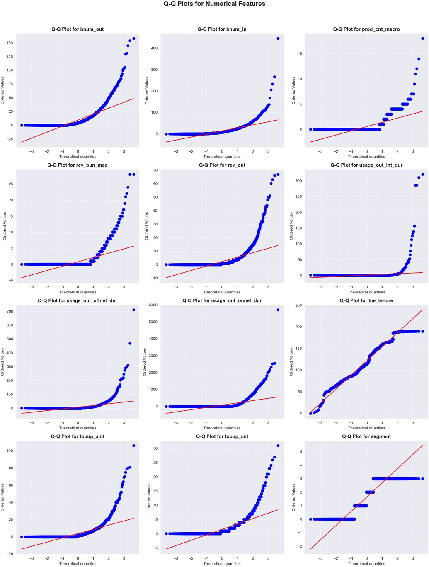

Prediction model selection
Q-Q
Plotting
According to the task requirements, we need to build a
Binary Classification model
I chose Gradient Boosting because this method is best suited for working with data that:
Do not have a normal distribution, as the algorithm uses decision trees that are insensitive to the scale and distribution of data
May contain outliers and missing values, which gradient boosting handles effectively
Require the modeling of complex nonlinear dependencies between features and the target variable

Slide 5
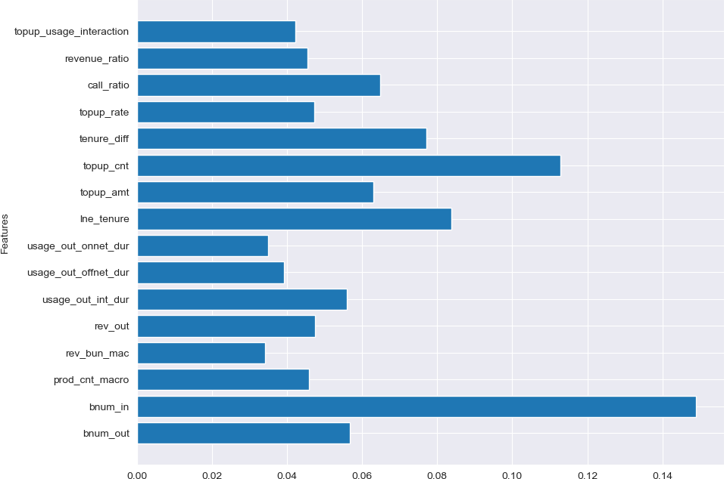

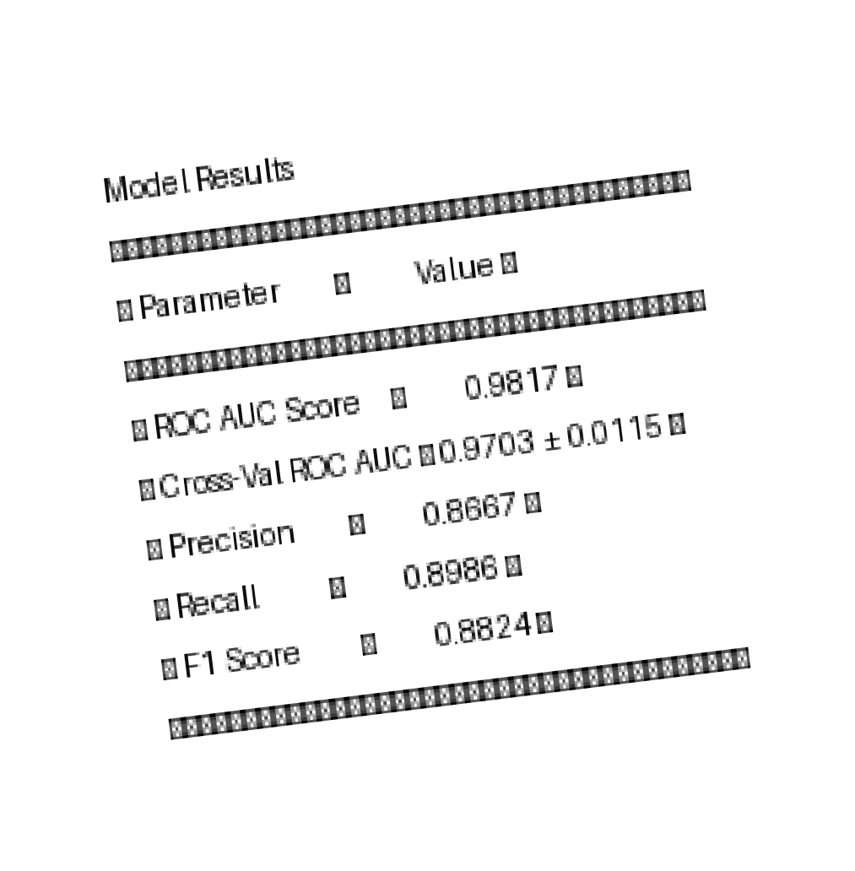
Success!
Model successfully identifies customer churn with high accuracy Key features provide actionable insights for retention strategies Limitations: Imbalanced data in certain segments
1
Integrate model predictions into customer management system
2
Conduct A/B testing with churn reduction strategies
3
Collaborate with Data Engineers to further enhance data quality
Monitor data quality and model performance regularly and retrain as needed
4
Hvala lepo!

